Slide 1
MRA Project Part A
User name: Rajesh MAmbulli
batch: PGPDSBA.O.SEP24.A
Email: rajeshmambulli@icloud.com

Slide 2
Agenda – Part A: Customer Behavior Analysis & Segmentation Strategy
Business Overview: Introduction to the company and the analytical challenge.
Problem Statement & Objectives: Key questions and business goals driving the analysis
Data Understanding: Structure and variables of the transactional dataset
Exploratory Data Analysis (EDA): Key patterns, sales trends, and product-level insights
Insights from EDA Highlights of customer behavior and potential segmentation cues
Customer Segmentation (RFM Analysis): Methodology for RFM scoring and segment creation
Segment Profiles & Behavioral Inference: Interpretation of segments and their business implications
Targeted Marketing Strategy: Actionable recommendations tailored to each segment
KNIME Workflow Overview: Analytical pipeline and tools used for implementation
Conclusion & Strategic Impact: Summary of insights, projected business benefits, and future scope

Slide 3
Business Overview
An automobile parts manufacturing company has been actively selling products to a diverse range of customers for the past three years. Despite its growth, the company lacks the in-house expertise to derive actionable insights from its transaction data. As a result, they wish to uncover hidden patterns and trends in their customer transactions. By analyzing this data, the company aims to better understand customer behavior, improve customer segmentation, and implement targeted marketing strategies. These insights will help the company not only enhance customer satisfaction but also drive revenue growth by offering more personalized and efficient services.

Slide 4
Problem Statement
Objective:
The primary objective of this analysis is to leverage data science techniques to:
Identify underlying patterns in customer purchasing behavior.
Segment customers based on their transactional data.
Provide actionable insights to optimize the company's marketing efforts.
Recommend personalized marketing strategies for each customer segment to maximize sales and customer retention.
Your role as a Business Analyst is to use the provided dataset to achieve these goals and present findings in a manner that can guide the company's decision-making.

Slide 5
Data Description
The dataset provided contains three years of transactional data from the company, with each row representing a unique order. Below is an explanation of the key attributes:
ORDERNUMBER: Unique identifier for each order.
QUANTITYORDERED: Number of items ordered in a specific transaction.
PRICEEACH: Price per unit of the product in the order.
ORDERLINENUMBER: Sequence number of the product in the order.
SALES: Total sales value for the order.
ORDERDATE: Date when the order was placed.
DAYS_SINCE_LASTORDER: Number of days since the customer's previous order.
STATUS: Current status of the order (e.g., Shipped, Disputed).
PRODUCTLINE: Product category to which the item belongs (e.g., Motorcycles, Classic Cars).
MSRP: Manufacturer’s Suggested Retail Price for the product.
PRODUCTCODE: Unique identifier for the product.
CUSTOMERNAME: Name of the customer placing the order.
PHONE: Customer's contact phone number.
ADDRESSLINE1: Customer's primary address.
CITY: City of the customer's address.
POSTALCODE: Postal code of the customer's address.
COUNTRY: Country of the customer's address.
CONTACTLASTNAME: Last name of the customer’s contact person.
CONTACTFIRSTNAME: First name of the customer’s contact person.
DEALSIZE: Size category of the transaction (e.g., Small, Medium, Large).

Slide 6
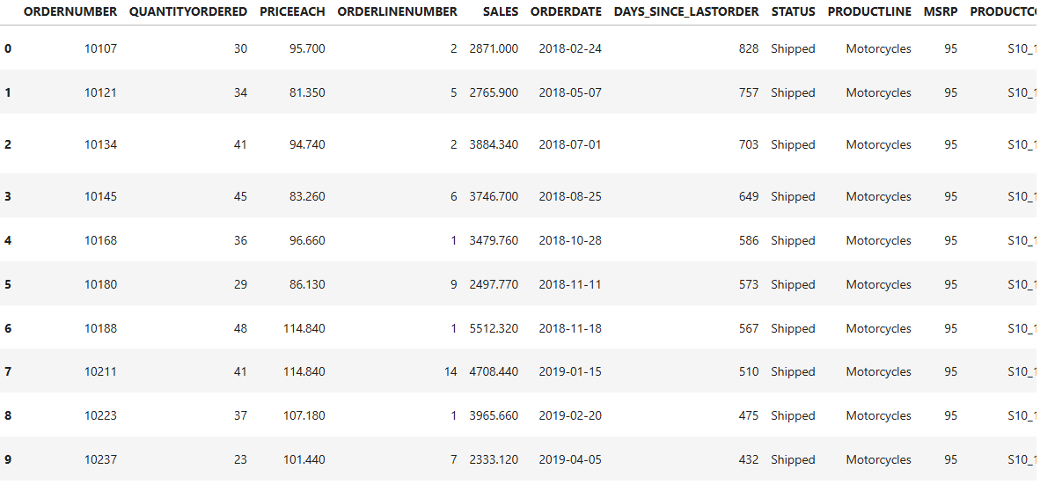
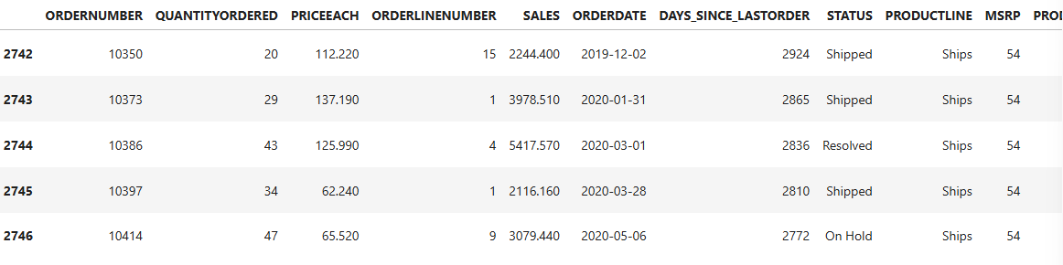
EDA STARTS
This is Head and Tail of the provided Sales Data

Slide 7

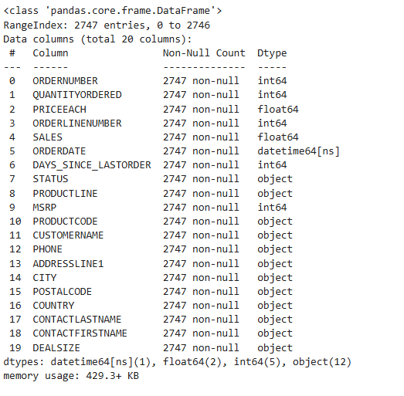
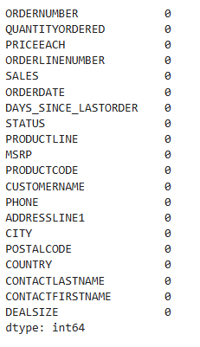

EDA cont..
All the Datatypes are correct no intervention is required.
No Duplicates in the data
No Missing values in the data

Slide 8
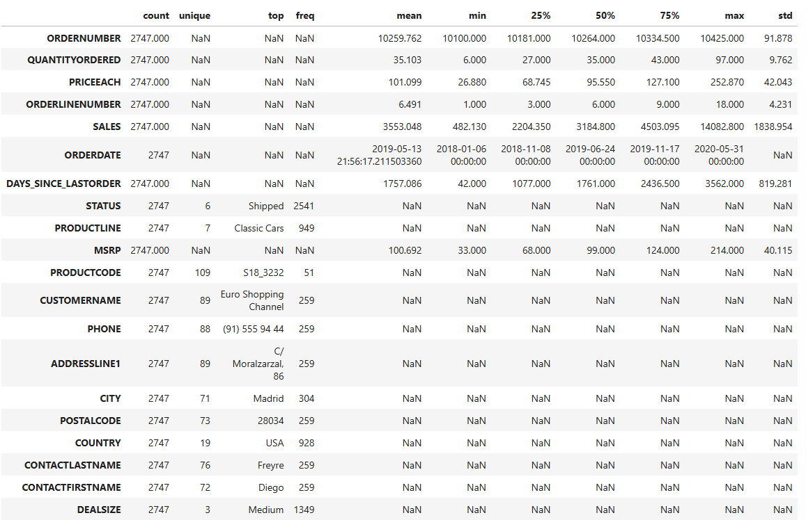
EDA cont..
Total Records: 2,747 transactions
Order & Sales Metrics:
Average Quantity Ordered: ~35 units per order
Average Price Each: ₹101.10
Average Sales per Line Item: ₹3,553
Max Sales: ₹14,082.80
Order Timing:
Order Dates: Range from Jan 2018 to May 2020
Days Since Last Order: Mean ~1,757 days, with a wide spread (min 42, max 3,562)
Product & Customer Insights:
Top Product Line: Classic Cars (949 entries)
Most Frequent Product Code: S18_3232
Top Customer: Euro Shopping Channel (259 orders)
Top Order Status: Shipped (2,541 orders)
Data Distribution:
Most numeric fields like QUANTITYORDERED, PRICEEACH, and SALES show moderate variability, suggesting a diverse range of order sizes and values
MSRP and PRICEEACH are fairly aligned, indicating pricing consistency

Slide 9
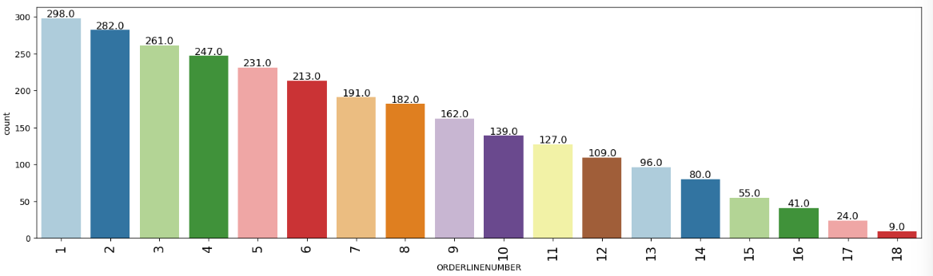
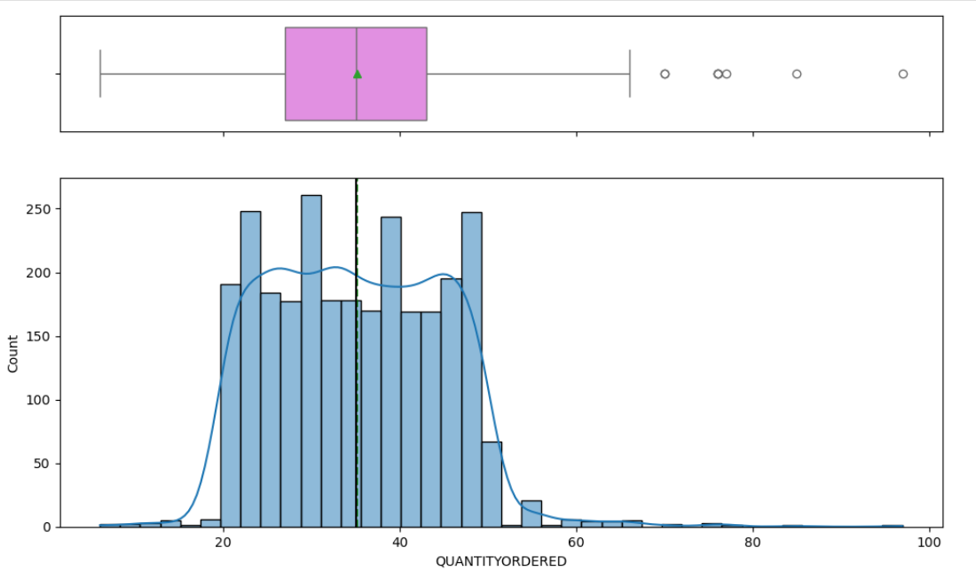
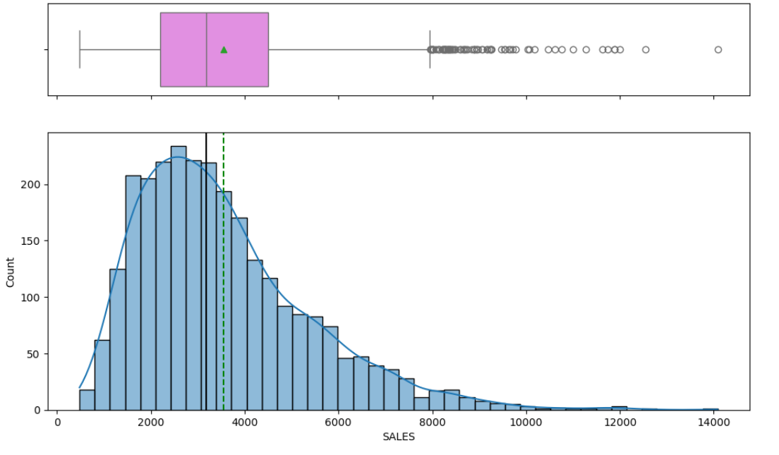
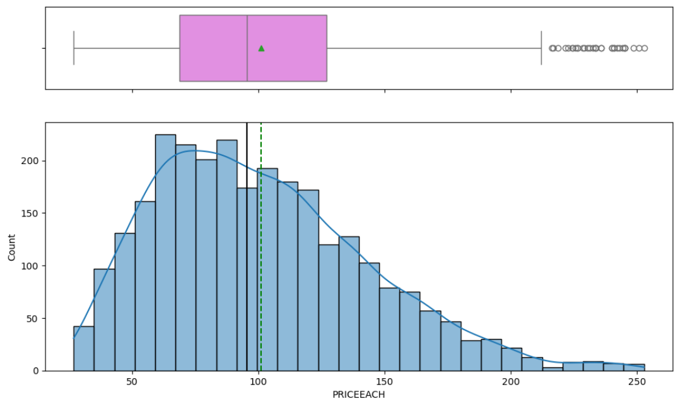
EDA cont..
OrderLineNumber: Most orders include just a few items, with 70%+ of transactions involving top 1–5 product lines. Indicates focused purchasing behavior.
QuantityOrdered: Median order quantity centers around 35 units. While most customers order within a consistent range, some place bulk orders.
Sales: Sales per line-item average around ₹3,500. Most transactions are moderate in value, but high-value outliers.
PriceEach: Product prices are tightly clustered near ₹100, with a few premium outliers. This stability suggests a standardized pricing model

Slide 10
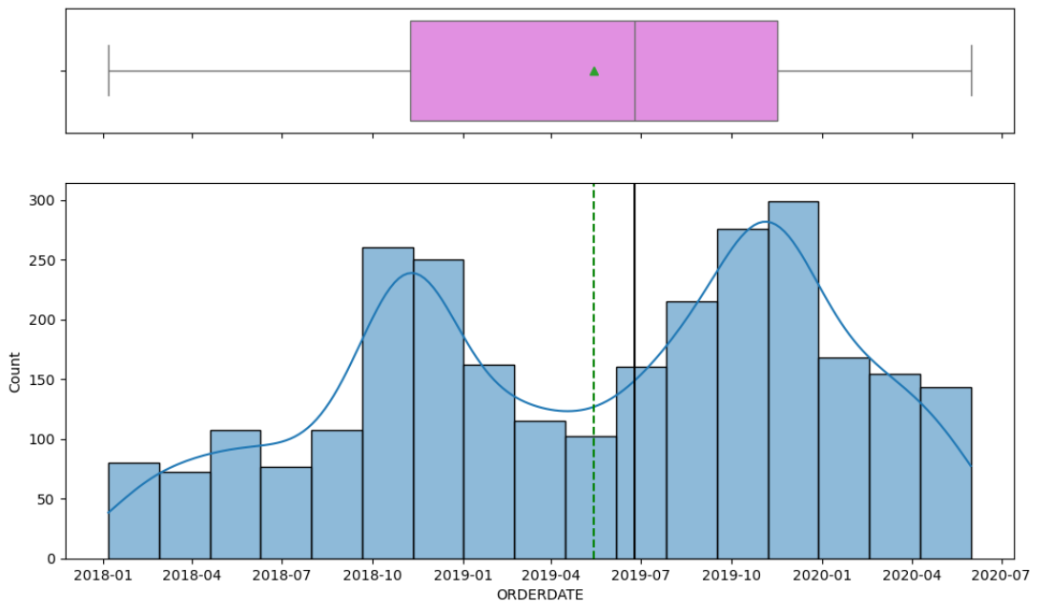
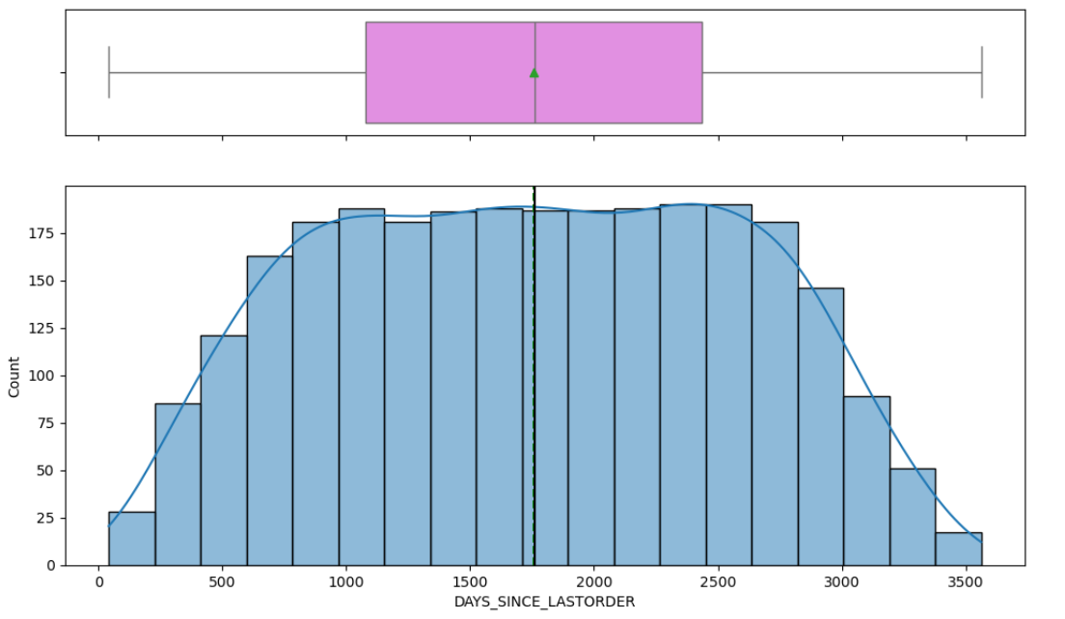
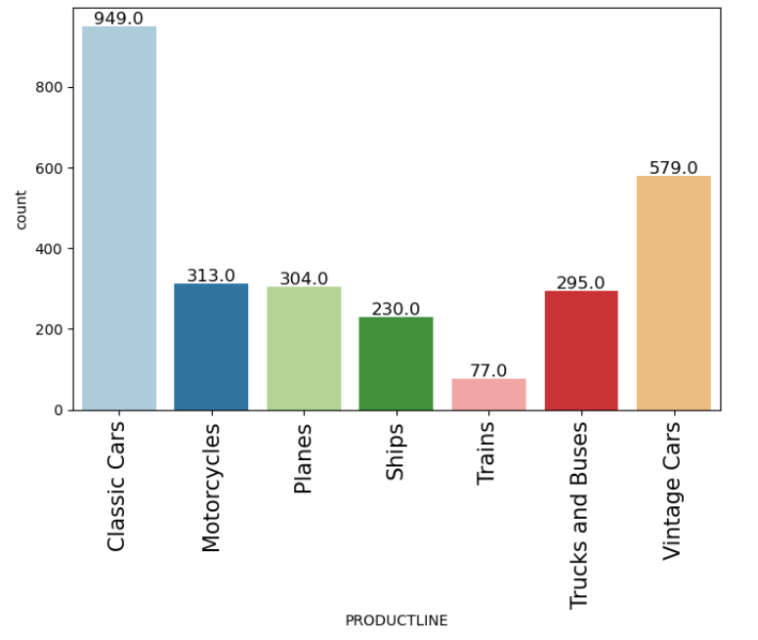
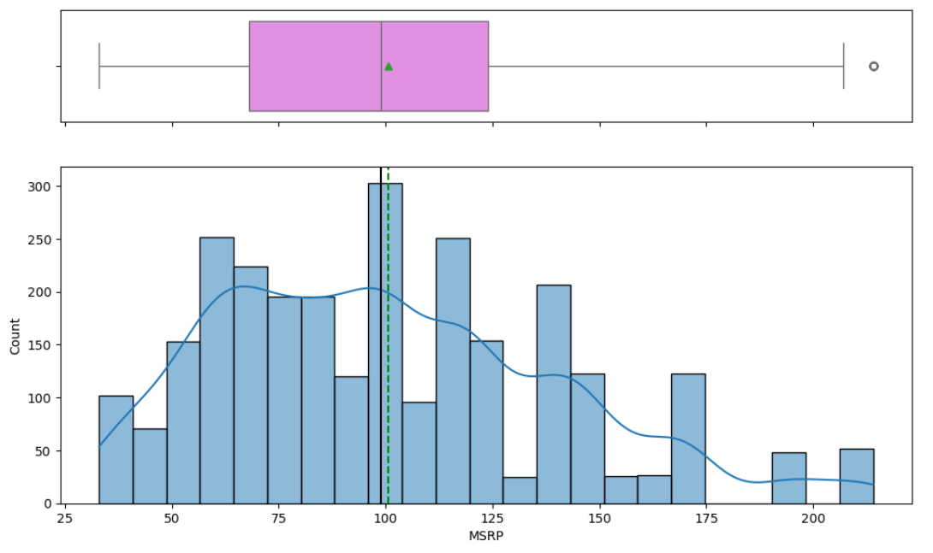
EDA cont..
Order Trends Over Time: Orders span from Jan 2018 to July 2020, with peak activity in April–July 2019, suggesting a period of increased demand.
MSRP Distribution: Most products have an MSRP clustered around ₹100, reflecting a standardized pricing strategy. A high outliers.
Product Line Performance:
Top Performer: Classic Cars dominate with 949 orders.
Strong Contenders: Vintage Cars (579) and Motorcycles (313) maintain substantial demand, suggesting secondary growth areas.

Slide 11
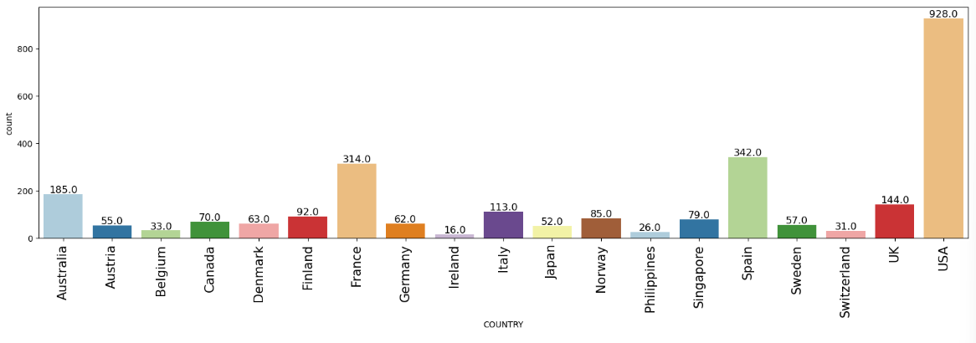
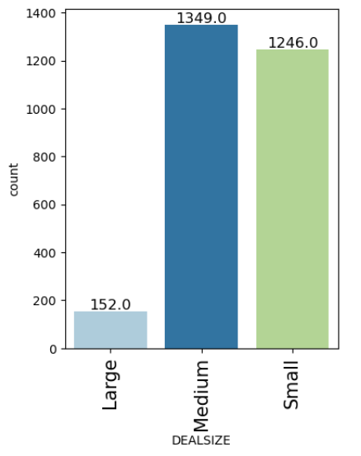
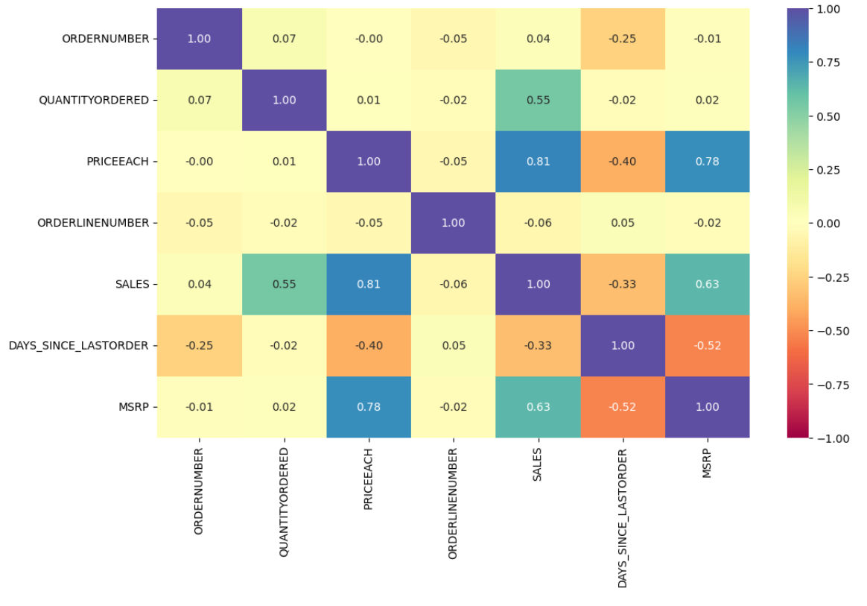
EDA cont..
Geographic Focus: USA dominates customer count (928), followed by Spain (342) and France (314)—these are your core markets. Moderate reach in countries like Australia, Finland, and Italy suggests growth potential with region-specific strategies. Low-count regions such as Ireland and Philippines may need reevaluation or tailored penetration strategies.
Deal Size Dynamics: Medium (1,349) and Small (1,246) deals form the business backbone—ideal for scalable, campaign-based marketing. Large deals (152), though limited in volume, are likely high-value, justifying strategic relationship-building and loyalty programs.
Key Correlations Driving Business Impact:
SALES strongly correlate with PRICEEACH (0.81) and MSRP (0.63)—price optimization directly influences revenue.
PRICEEACH ↔ MSRP correlation (0.78) confirms consistent pricing strategy.
DAYS_SINCE_LASTORDER is negatively correlated with SALES (-0.33) and MSRP (-0.52), revealing that longer gaps between purchases reduce revenue—a compelling reason to implement re-engagement campaigns.

Slide 12
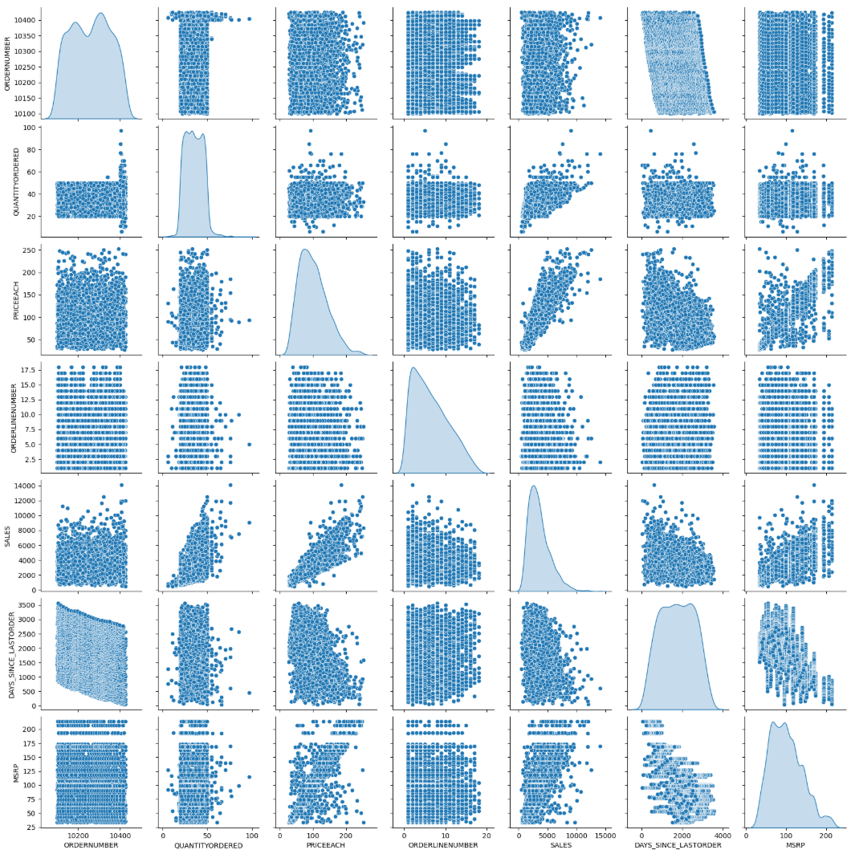
EDA cont..
SALES vs. PRICEEACH: A strong positive correlation suggests that higher-priced items tend to generate more revenue.
SALES vs. MSRP: A similar positive correlation implies that products with a higher MSRP are often sold at a higher price point.
QUANTITYORDERED vs. SALES: If there’s a noticeable trend where higher quantities lead to higher sales, bulk purchasing might be a key driver.
DAYS_SINCE_LASTORDER vs. SALES: A weak correlation here might indicate irregular purchasing behaviors, signaling opportunities for retention-focused marketing strategies.
Some histograms show right-skewed distributions (e.g., PRICEEACH and MSRP) indicating that most transactions involve lower-priced items, but occasional high-value orders skew the data.

Slide 13
EDA SUMMARY [INFERENCES]
1. Order & Purchase Behavior:
Majority of transactions include just 1–5-line items, suggesting focused customer intent and a strong case for bundling core products.
Quantity Ordered centers around 35 units, with occasional large orders—indicative of both routine buyers and high-volume clients.
2. Pricing & Revenue Patterns
Both Price Each and MSRP cluster around ₹100, reflecting pricing consistency, with a few premium items suitable for upselling.
Sales per line-item averages ₹3,500, with outliers suggesting high-value customers that could be nurtured through loyalty programs.
3. Temporal Trends
Orders span Jan 2018 to July 2020, peaking mid-2019—likely due to seasonal campaigns or demand surges.
DAYS_SINCE_LASTORDER is broadly spread, revealing an inconsistent customer return cycle—pointing to the need for re-engagement strategies.
4. Product & Customer Segments
Classic Cars dominate product orders, while Trains and Ships lag—valuable input for targeted promotions and inventory prioritization.
USA leads customer count, followed by Spain and France—highlighting strong North American and Western European presence.
5. Deal Sizes & Value Segmentation
Business is anchored by Medium and Small deals (97% combined), with Large deals offering strategic high-revenue potential.
Geographic and product insights can guide market-specific targeting and volume-based incentives.
6. Correlations & Multivariate Patterns: Strong positive correlations:
Price Each ↔ Sales (0.81)
Price Each ↔ MSRP (0.78) → Pricing is a primary lever for revenue generation.
DAYS_SINCE_LASTORDER shows negative correlation with Sales—the longer customers go inactive, the less they spend.

Slide 14
RFM Starts
Customer Segmentation using RFM analysis:
Number of Segments: 3
Justification: Based on distinct RFM score groupings and customer behavior, the customers are segmented into Active, At-Risk, and Inactive categories. This trisection balances simplicity with strategic focus:
Active: High recency, frequency, and monetary value.
At-Risk: Moderate scores, with signs of potential churn.
Inactive: Low engagement across RFM dimensions.
This segmentation helps in tailoring marketing strategies with precision—targeting loyalty initiatives, re-engagement efforts, and reactivation campaigns respectively.
Parameters Used: RFM model considers:
Recency (R): Days since the customer's last purchase (lower is better).
Frequency (F): Total number of transactions by the customer.
Monetary (M): Total sales revenue generated by the customer.
Assumptions Made:
Higher scores on Frequency and Monetary represent more loyal, profitable customers.
Lower values on Recency indicate recent activity and thus, a higher likelihood of engagement.
Scoring was done on a scale (e.g., 1–3) for each RFM component, and summed or clustered to assign segment labels.
Recency:
High (H) → Customer purchased recently
Medium (M) → Moderate time since last purchase
Low (L) → Long time since last purchase
Frequency & Monetary:
High (H) → Frequent and/or high-value spender
Medium (M) → Moderate purchase frequency/value
Low (L) → Infrequent or low-value purchases

Slide 15
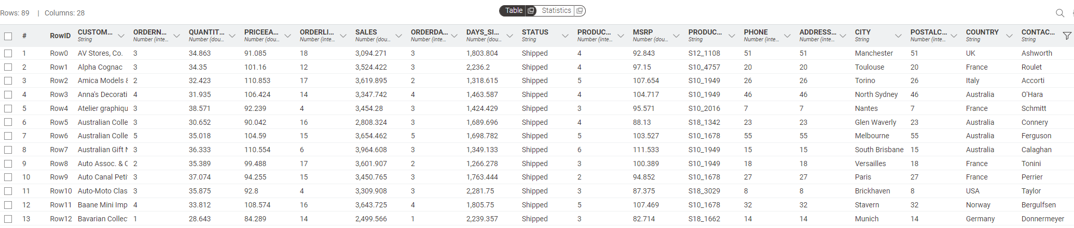
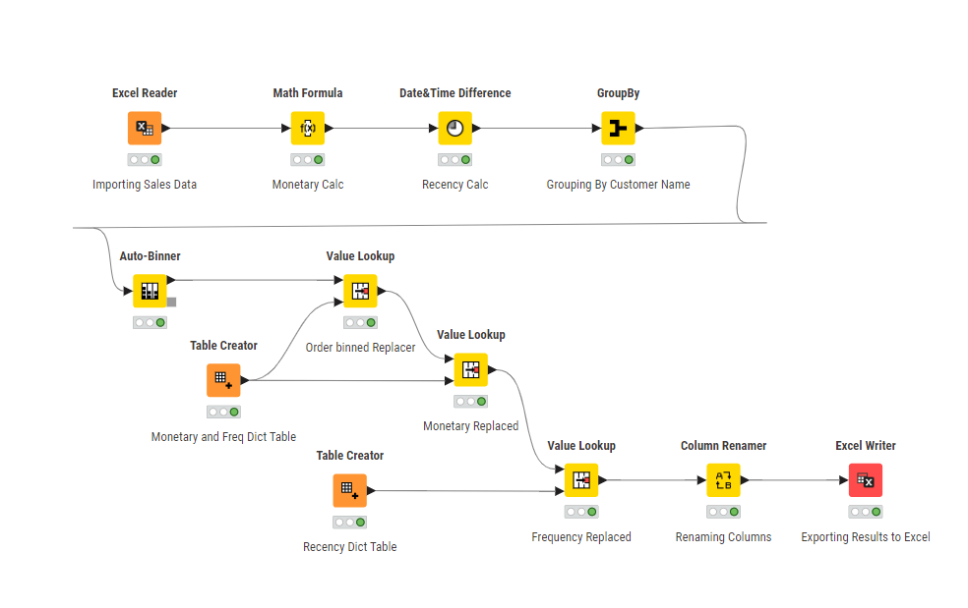
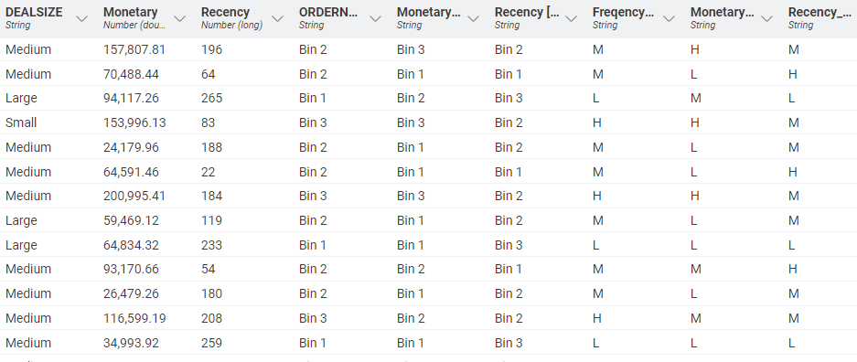
RFM (using KNIME)
KNIME Workflow:
Output table

Slide 16
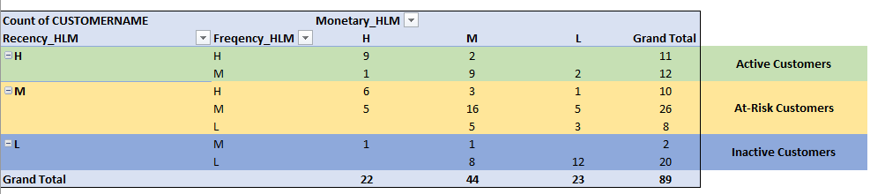
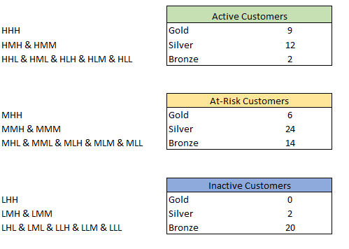
RFM (using KNIME) Inferences
Insights
Active Customers (23 Total):
Gold Tier (9 customers): These are your most loyal and profitable segment. They've purchased recently, frequently, and in high amounts.
Silver Tier (12 customers): Still valuable—slightly lower on one or two RFM dimensions but show strong potential.
Bronze Tier (2 customers): Actively buying, but either less frequently or with smaller purchase values.
At-Risk Customers (44 Total)
Large concentration in Silver (24) and Bronze (14): These customers were previously engaged but haven't purchased recently.
Gold (6 customers): Once very valuable—if they’re starting to lapse, this is a red flag worth immediate attention.
Inactive Customers (22 Total)
Mostly Bronze (20 customers): These likely had infrequent, low-value transactions and have since disengaged.
Silver (2 customers), Gold (0): Indicates minimal high-potential customers have become completely inactive.

Slide 17
RFM (using KNIME) Inferences
Recommendations:
Nurture Active Customers
Gold Tier: Offer exclusive loyalty perks, sneak peeks at new products, or early-bird deals.
Silver Tier: Encourage upselling and cross-selling with personalized product bundles.
Bronze Tier: Use satisfaction surveys or onboarding-style communication to build stronger habits and move them up.
Win Back At-Risk Customers
Send "We miss you" emails with time-sensitive promotions.
Re-target them via ads showing products similar to past purchases.
Offer tier-based incentives to encourage re-engagement—perhaps a one-time boost to reach Silver or Gold status.
Revive Inactive Customers
Launch a reactivation campaign with bold offers (e.g., 25% off next order) or fresh messaging focused on new arrivals.
Use feedback forms to identify pain points that may have caused disengagement.
Focus retention resources on Bronze-level customers only if acquisition costs are lower than potential return.

